Slide 1

FOLLOWING
WCAG GUIDELINES FOR WEB
ACCESSIBILITY
HTTP 418
Alex
Amy
Ian
Kevin
Roger

Slide 2
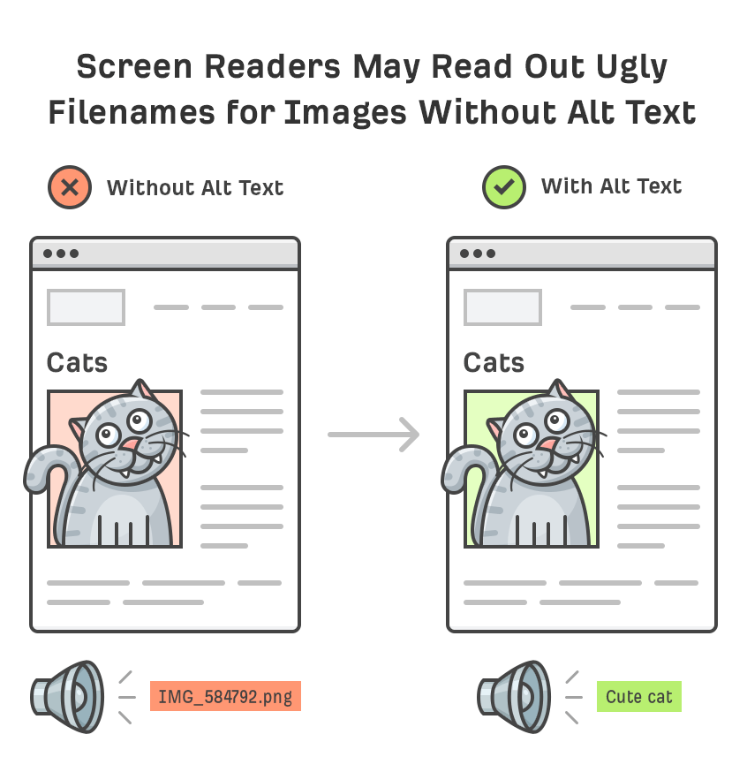
Image Alt Text
Guideline 1.1 Text Alternatives
Provide text alternatives for any non-text content
Image Alt Text
Descriptive text for images for users who may have issues perceiving content
Using correct html tags to ensure alt text is readable by screen readers

Slide 3
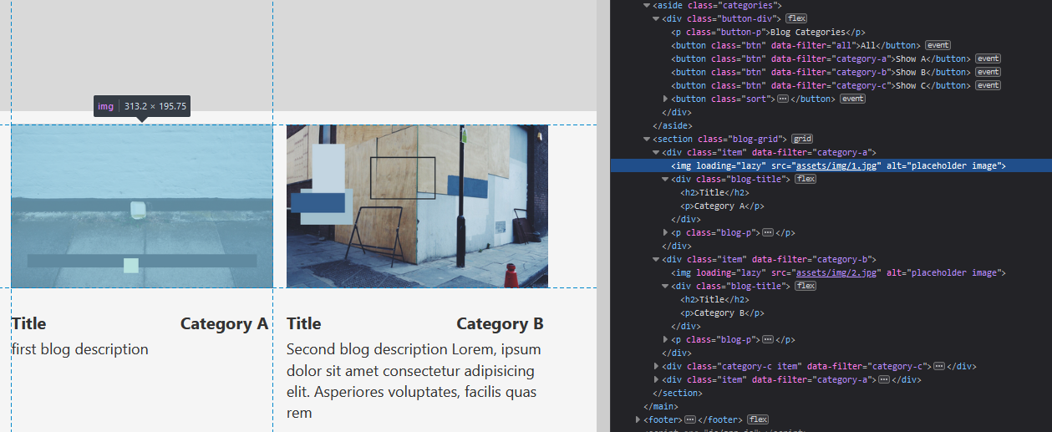
We plan to add alt tags to all media objects
Make sure alt tags are unique and descriptive of media contents

Slide 4
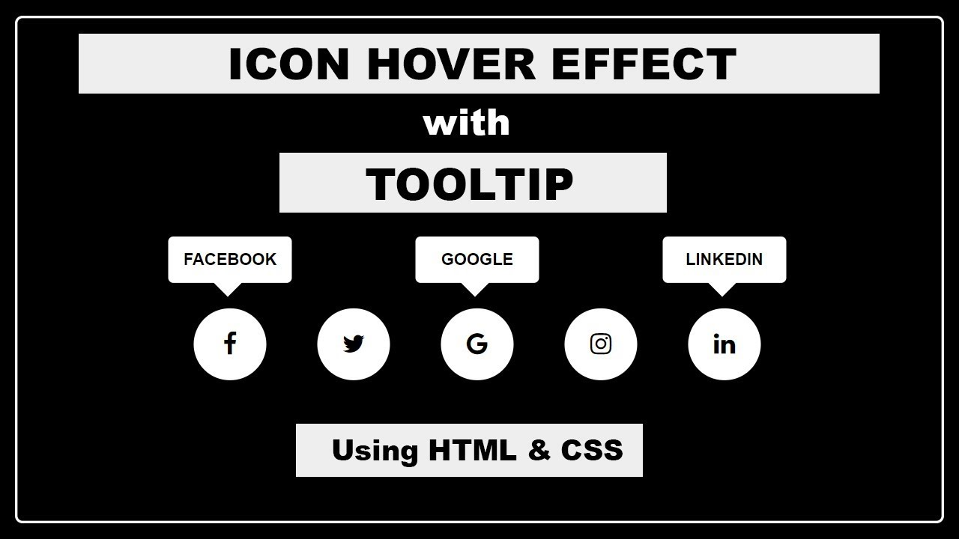
Icon Tooltips
Guideline 1.1 Text Alternatives
Provide text alternatives for any non-text content
Adding descriptive text to icons prevents confusion and ensures site navigation can be understood
Tooltips should persist until the hover is removed or the user dismisses the message
Potential Challenges
Making sure tooltips include text alternatives that can be read by screen readers
Ensuring keyboard accessibility
Regularly test the tooltips with assistive technologies, such as screen readers, to ensure that they are accessible and usable for users with disabilities.

Slide 5
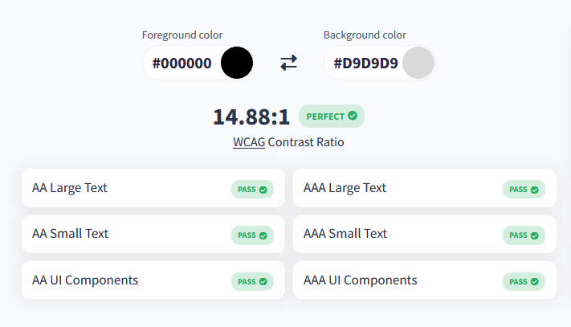
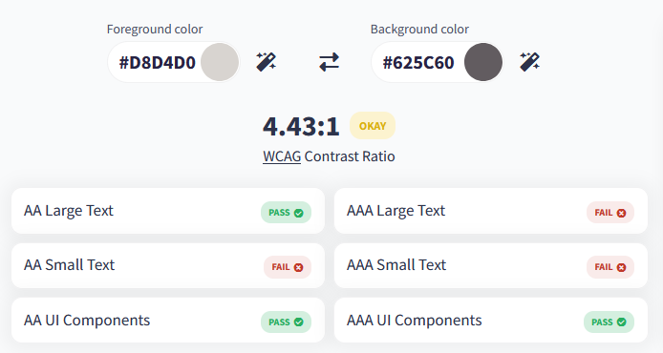
Color Contrast
Light Mode
Guideline 1.4 Distinguishable
Make it easier for users to see and hear content including separating foreground from background.
The visual presentation of text and images of text has a contrast ratio of at least 4.5:1
We will be using a contrast checker to verify color schemes are WCAG Compliant
Dark Mode
Potential Challenges
Implementing dark mode means two complete color schemes to be evaluated
After using color checker, we found that our dark mode is not fully WCAG compliant so we will need to re-evaluate

Slide 6

Text Size
Guideline 1.4 Distinguishable
Make it easier for users to see and hear content including separating foreground from background.
Except for captions and images of text, text should be able to be resized without assistive technology up to 200 percent without loss of content or functionality.
Potential Challenges
Ensuring the integrity of the content is preserved as text size is scaled up or down

Slide 7
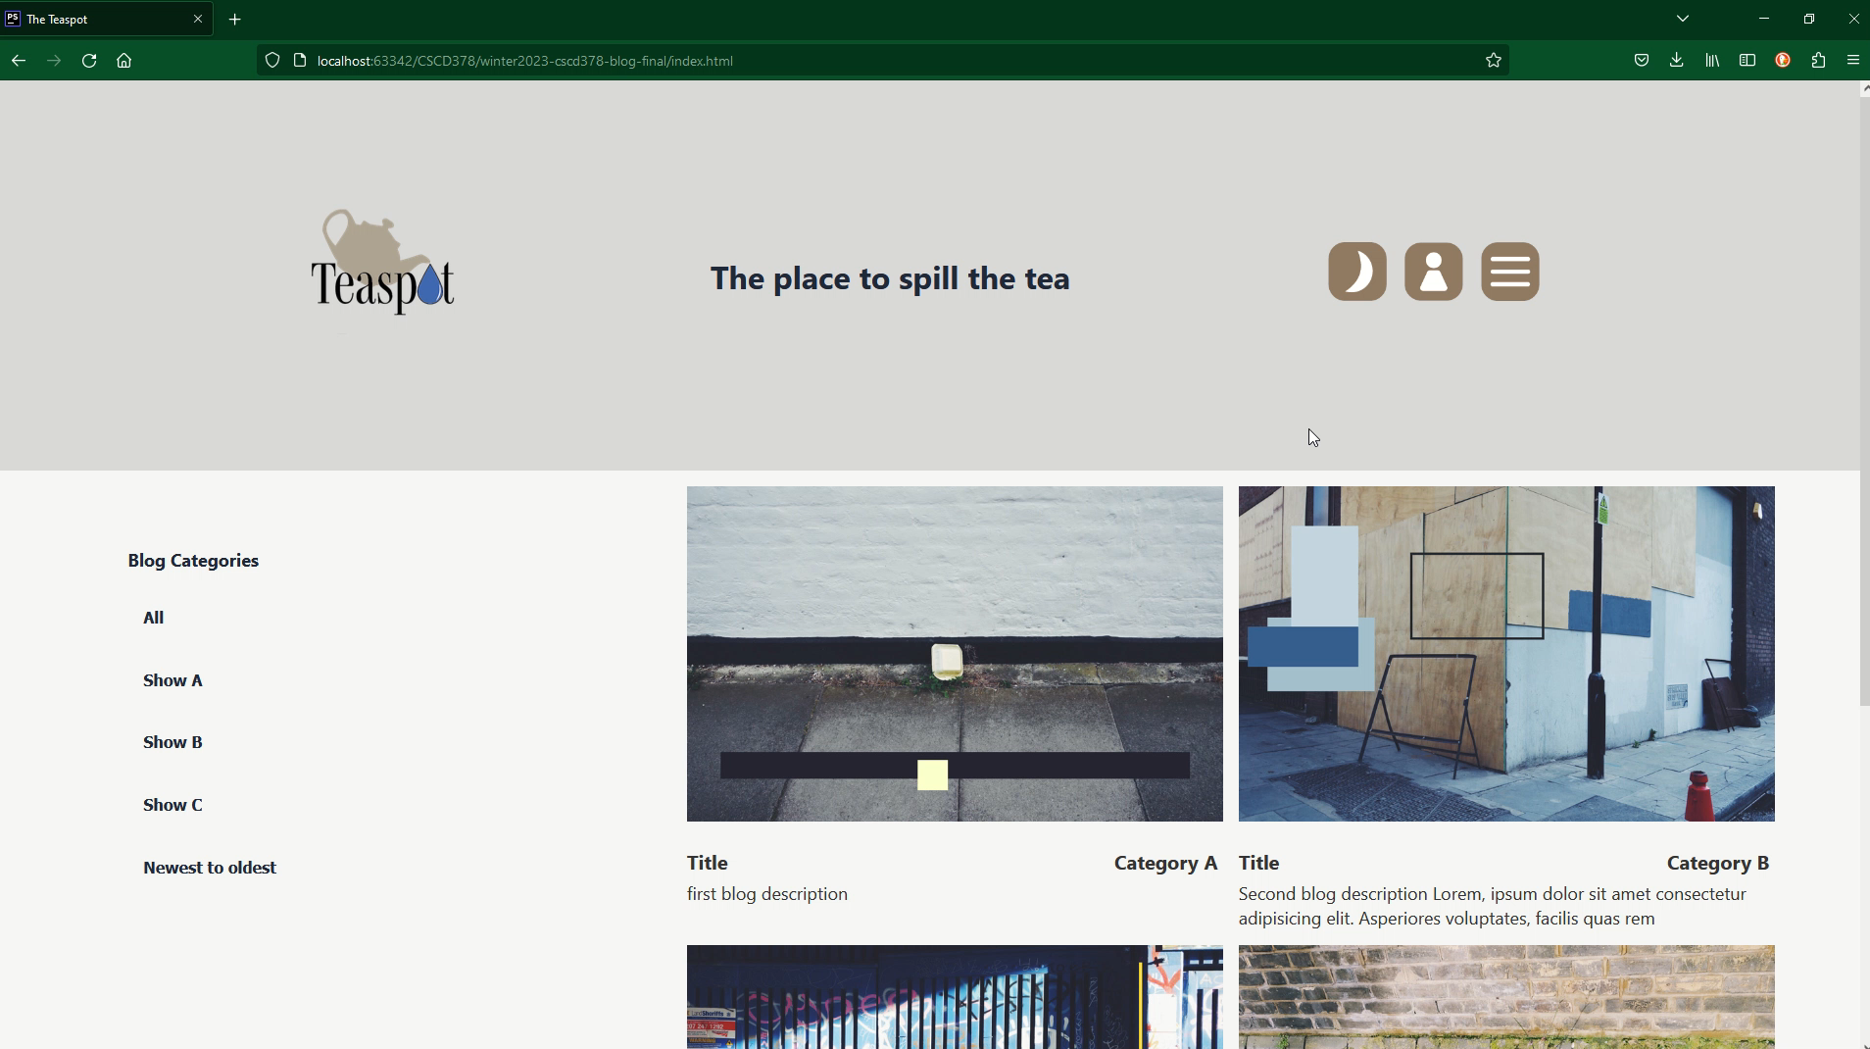
Operable

Slide 8

Keyboard Accessibility
Guideline 2.1 Keyboard Accessible
Functionality should be accessible from the keyboard
Logical tab order
Keyboard friendly navigation menus, links, and buttons
Potential Challenges
Making sure all interactive elements are accessible through tabbing
Making sure tab order follows a logical, linear path

Slide 9


Slide 10

Navigation
Guideline 3.2 Predictable
Make Web pages appear and operate in predictable ways
Consistent Navigation
Navigational mechanisms that are repeated on multiple Web pages occur in the same relative order each time they are repeated
We will be implementing a header and footer with a navigation options that will remain consistent on every page
We hope to create a layout and navigation structure that can be easily navigated using only the keyboard.

